Slide 1
Sprint 4 Presentation:
Gideon Quaye, Dylan Welsh

Slide 2

Challenges Faced:
Meeting times
“Availability”
Understanding robot movement
Comprehending how to use the sphero edu software
Learning how to use GitHub correctly and put all the correct robots information in the Repository.

Slide 3

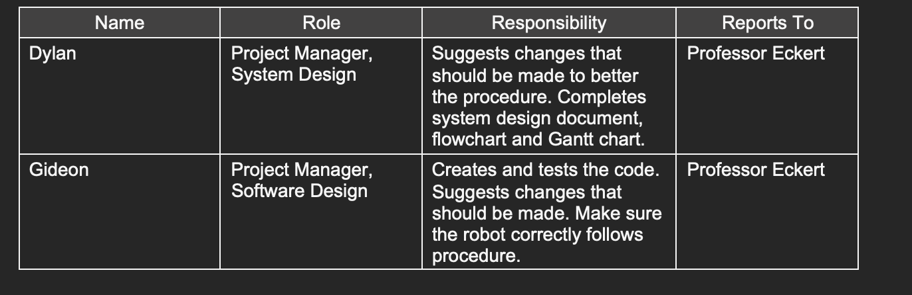
Roles of each Team Member:

Slide 4


What we learned about Software Engineering
We gained the following knowledge about software engineering from this project:
A project need more than one person to finish it.
Your secret to success is time management.
An essential component of finishing these initiatives is communication.
In order to complete your assignment, there will be a lot of trial and error.
You need to be aware of what has to be finished and completed.

Slide 5

What we would do differently?
Work around each others schedules more
Making sure the Robot is completely charged before meeting with team
TAKE MORE TIME!

Slide 6
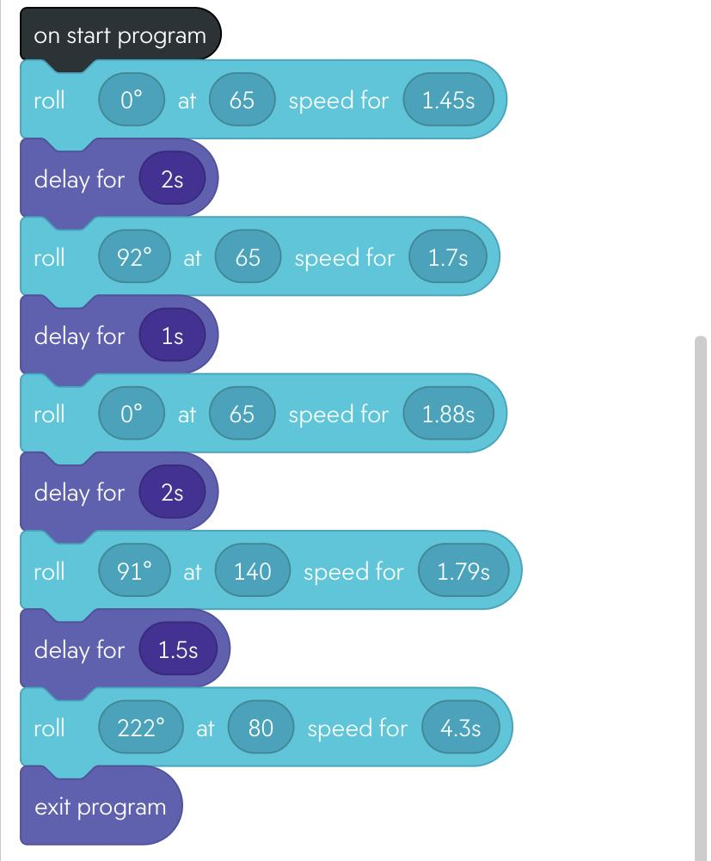

Sprint 3 Block Code:

Slide 7
Agility Sprint Video:
https://youtube.com/shorts/jtnqXAUU0hc

